Slide 1

Oct, 2015
HAMLET@UW-Madison
Modeling the development of children’s cognitive skills with connectionist framework:
Integrating cognitive theory and neuroimaging data
Lang Chen
Stanford University

Slide 2






Outline
Behavioral and neuroimaging data on strategy use in arithmetic problem solving
Vinod Menon
Shaozheng Qin
A toy model to connect the theory and data
The on-going modeling project for the development of strategy use over development
The on-going modeling project for the development of strategy use over development
The on-going modeling project for the development of strategy use over development
And many summer interns
Shaozheng Qin
Christian Battista
Tanya Evans
Jeff Shrager

Slide 3
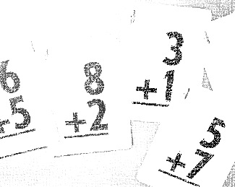
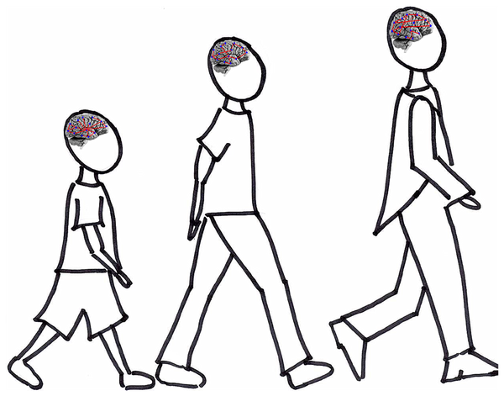
Introduction
The ability to efficiently retrieve basic facts from memory and bring them to bear into ever-changing situations is a cardinal feature of children’s cognitive development. (Siegler, 1996; Geary, 2006)
Little is known about how this ability develops as the brain matures from childhood through adolescence into adulthood?

Slide 4
Introduction
Children’s mix of multiple strategies in arithmetic problem solving
4 + 7 = ?
Rote counting
Strategy 2
Strategy 3
Fact retrieval
4, 5, 6, 7, 8, 9, 10, 11
7 + 4
4 + 7
11
Semantic-like memory
Associative memory
7, 8, 9, 10, 11
11

Slide 5
Introduction
Overlapping waves theory in children’s math problem solving
Rote counting
Fact retrieval
Strategy 2
Strategy 3
Percentage use
Age & Experience
(Adapted from Chen & Siegler, 2000)
Over development, children become more dependent on memory-based retrieval of math facts and less dependent on effortful counting strategies.
These transitions are associated with high inter-trial variability in RTs during childhood, become refined and more stable through adolescence into adulthood.

Slide 6
Experimental Questions
Neural correlates of arithmetic problem solving in children and adults
Quantity & numeracy representation system
Working memory & cognitive control system
Declarative memory system

Slide 7
Aims
Longitudinal fMRI
in children
Cross-sectional adolescents and adults
?
Strategy 1
Fact retrieval
Strategy 2
Strategy 3
Percentage use
Age & Experience
Aim 1: Investigate brain systems underlying the transition from use of counting toward memory-based retrieval to solve arithmetic problems
Aim 2: Investigate brain-behavior relationship between representations of problems and children’s mix of strategy use with high variability in RTs

Slide 8
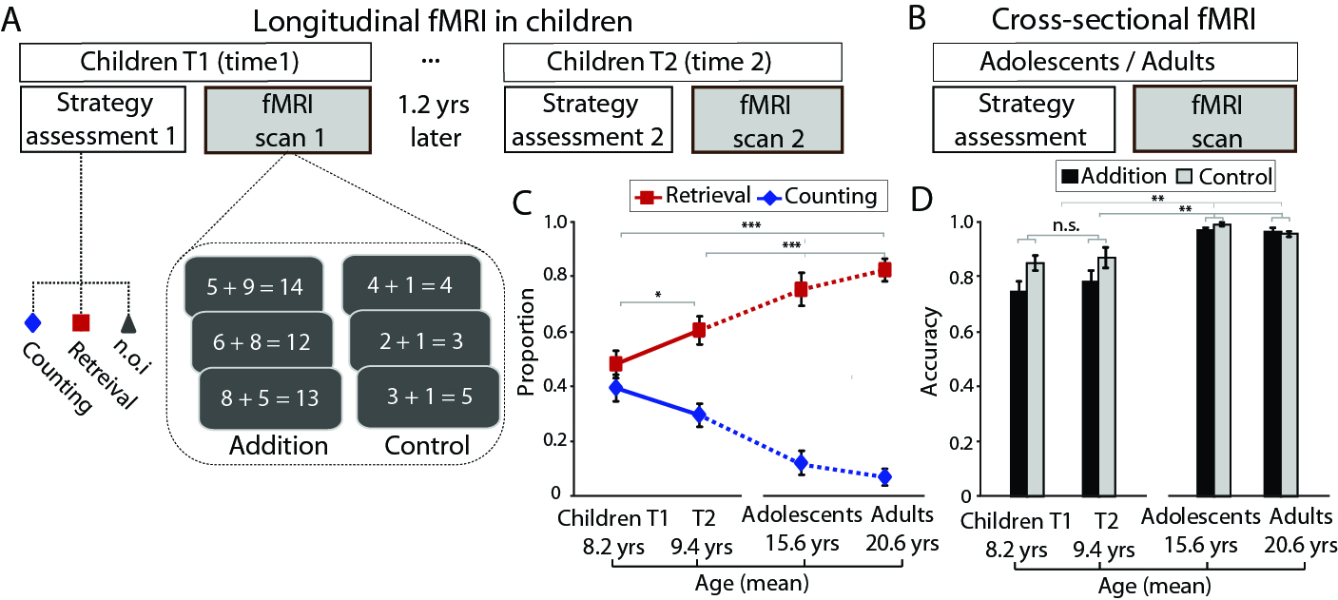

Aim 1: Experimental Design
Participants
28 young children (aged 7–9 year-old at Time 1; aged 9–11 at Time 2)
20 adolescents (aged 15–17) ; 20 adults (aged 19–22)
@Qin et al., 2014 Nat Neurosci.

Slide 9
Aim 1: Behavioral Results
Developmental changes in strategy use during problem solving
Over a 1.2-year period children became more dependent on memory-based strategy use and less dependent on effortful counting strategies.
This pattern continues to improve during adolescence and adulthood.
@Qin et al., 2014 Nat Neurosci.

Slide 10
Aim 1: Neuroimaging Results
Brain systems involved in solving addition problems during childhood
@Qin et al., 2014 Nat Neurosci.

Slide 11
Aim 1: Neuroimaging Results
Longitudinal increase in hippocampal engagement during problem solving
@Qin et al., 2014 Nat Neurosci.

Slide 12
Aim 1: Neuroimaging Results
Longitudinal decrease in prefrontal-parietal engagement during problem solving
@Qin et al., 2014 Nat Neurosci.

Slide 13
Aim 1: Neuroimaging Results
Non-linear developmental changes in hippocampal engagement
from childhood through adolescence into adulthood
@Qin et al., 2014 Nat Neurosci.

Slide 14
Aim 1: Investigate brain systems underlying the transition from use of counting toward memory-based retrieval to solve addition problems
Aim 2: Investigate brain-behavior relationship between representations of problems and children’s mix of strategy use as reflected by inter-problem variability in RTs)
15
Notes:
.

Slide 15
Aim 2
Participants
20 young children (aged 7–9 year-old at time1, 9-11 year-old at time2)
20 adolescents (aged 15–17); 20 adults (aged 19–22)
@Qin et al., In Preparation

Slide 16
Aim 2: Behavioral Results
Developmental changes in accuracy and RTs during problem solving
Over a 1.2-year period children’s accuracy and RTs in problem solving significantly improved.
This pattern continues to improve in adolescence and adulthood.
@Qin et al., In Preparation

Slide 17
Aim 2: Inter-problem Variability in RTs
Developmental changes in inter-problem variability in RTs
@Qin et al., In Preparation

Slide 18
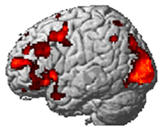
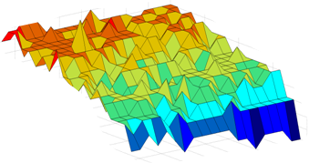
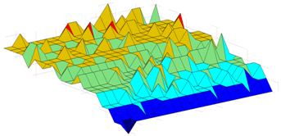
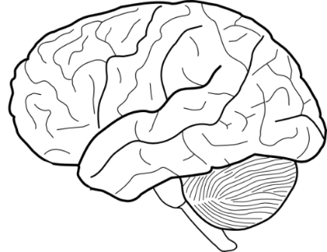
Aim 2: Multivoxel Pattern Analysis
Trial-wise analysis of inter-problem representation stability
Whole-brain searchlight method
Inter-problem representation stability matrix
Brain response patterns
…
Single-trial GLM
estimation maps
6 + 7 = 13
…
5 + 4 = 9
3 + 4 = 8
@Qin et al., In Preparation
Notes:
for subsequent group analysis.

Slide 19
Aim 2: Neuroimaging Results
No significant changes in inter-problem representation
stability between T1 and T2 during childhood
@Qin et al., In Preparation

Slide 20
Aim 2: Neuroimaging Results
Developmental changes in representation stability from childhood to adulthood
Over a 1.2-year period children’s inter-problem representation stability remains
no significant changes, but become more stable adolescence and adulthood.
@Qin et al. Nat Neurosci

Slide 21
Aim 2: Brain-Behavior Relationship Analysis
@Qin et al., In Preparation
Notes:
MAIN POINTS
To further investigate whether inter-problem representation stability is predictive of inter-problem variability in RTs, we conduct an innovative analysis of brain-behavior association between inter-problem representation stability and inter-problem variability in RTs.
-1- We took each participant’s inter-problem representation stability matrix and transformed into one-dimensional vector, and then computed its correlation with inter-problem variability in RTs for each voxel and created a brain-behavior correlation map.
-2- Each participant’s correlation map was then submitted into a second-level group analysis.

Slide 22
Aim 2: Neuroimaging Results
Longitudinal increases in brain-behavior relationship during childhood
@Qin et al., In Preparation

Slide 23
Interim Summary– Findings
Neurobehavioral features of children’s cognitive development
Childhood
(immature, unstable)
Strategy transitions counting → retrieval
High inter-problem variability in RTs
Increased recruitment of MTL-neocortical system
Low inter-problem representation stability
Adulthood (mature, stable)
Stabilized fact retrieval strategy use
Low inter-problem variability in RTs
Decreased recruitment of MTL memory system
High inter-problem representation stability
Rote
counting
Age & Experience
(Adapted from Chen & Siegler, 2000)
@Shaozheng Qin

Slide 24
Interim Summary – Puzzles
Many changes over development: control, noise, experience
Differences in using multiple strategies for all these findings?

Slide 25
Outline
Behavioral and neuroimaging data on strategy use in arithmetic problem solving
A toy model to connect the theory and data
The on-going modeling project for the development of strategy use over development

Slide 26
Children’s strategy transitions
Children’s mix of multiple strategies in arithmetic problem solving
4 + 7 = ?
(S1) Counting
(S2) Associative
retrieval
(S3) Fact retrieval
4, 5, 6, 7, 8, 9, 10, 11
7 + 4
4 + 7
11
Semantic-like memory
Associative memory
7, 8, 9, 10, 11
11
@ Project in progress

Slide 27
Aim 3: Computational Model Specification
Functional pathways underlying strategy transitions in problem solving
S1: Counting strategies mediated by dlPFC; S2: hippocampal-dependent associative memory retrieval; S3: hippocampal-independent semantic-like memory retrieval.
@ Project in progress

Slide 28
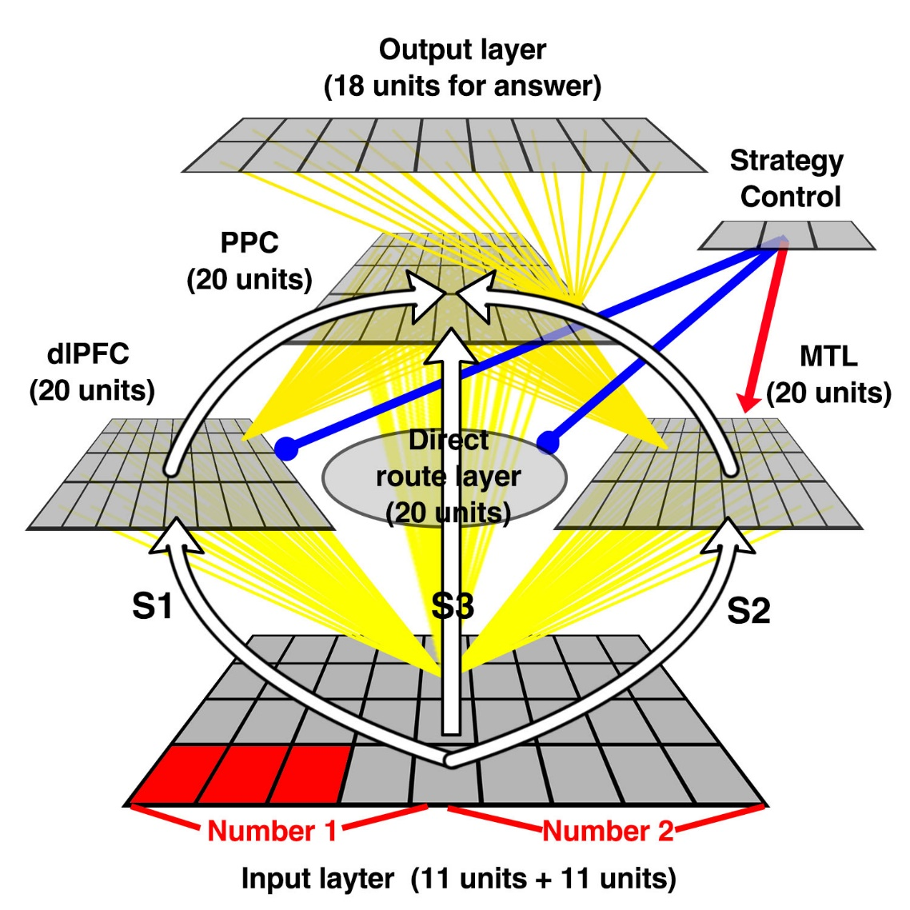
Aim 3: Model Parameters
Model architecture
Only forward connections from input → hidden layers → output
Strategy control units for modulating the processing efficiency of each neuropathway corresponding to each strategy.
Negative bias (-5) for hidden units for 0 initial activation
Control | S 1 | S 2 | S 3
dlPFC | 0 | -10 | -10
MTL | -10 | +1 | -10
Direct | -10 | -10 | +2
@ Project in progress

Slide 29
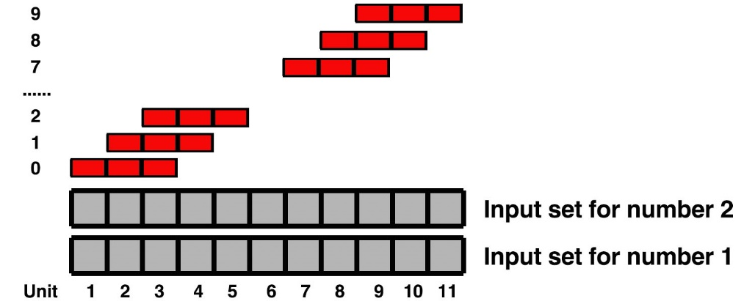
Aim 3: Model Parameters
Input and output representations
Distributed input representations for numbers from 0 to 9
Localist output representations for answers from 1 to 18
@ Project in progress

Slide 30
Aim 3: Model Parameters (Lang)
Manipulating strategy differences in testing environment
We created four sets of testing environment to reflect ratio of differences in strategy use
@ Project in progress

Slide 31
Aim 3: Stimulated Behavioral Outcomes
Developmental changes in accuracy for addition problem solving
@ Project in progress

Slide 32
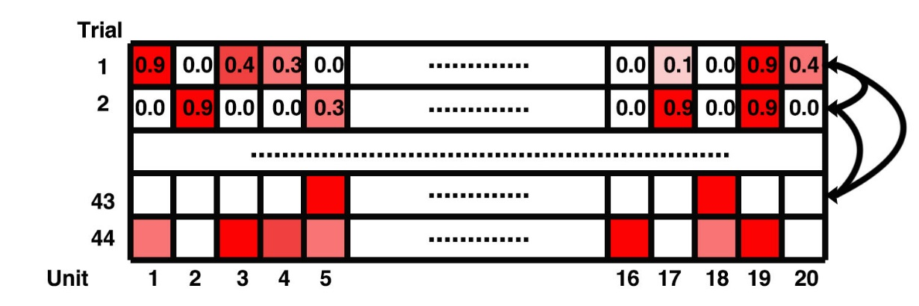
Aim 3: Stimulated Neural Activation and Representations
We therefore calculated the pairwise inter-problem absolute difference of 20-unit activity patterns to measure multi-unit representation stability.
@ Project in progress
37

Slide 33
Aim 3: Stimulated Brain-Behavior Correlation
Children T2 (Neuronal)
Children T2 (RTs)
X = Inter-problem neural similarity
Y = Inter-problem variability in RTs
Corr(X, Y)
@ Project in progress
38

Slide 34
Aim 3: Stimulated brain-behavior relationship
Developmental changes in brain-behavior correlation
Outcomes from computational modelling indicate similar non-linear developmental changes in neural activation, inter-problem representation stability and its relation with inter-problem variability in RTs.
@ Project in progress
39

Slide 35
Summary
Some success in capturing behavioral and neuroimaging data
Issues:
(a) The variety of strategies is overly simplified
(b) There is no explanation for transition or development of strategy use
(c) The interaction of language, control and sensory systems is absent

Slide 36
Outline
Behavioral and neuroimaging data on strategy use in arithmetic problem solving
A toy model to connect the theory and data
The on-going modeling project for the development of strategy use over development

Slide 37
General goal
Establish a computational framework for developing arithmetic skills
For a broader range of children from preschooler to children in early elementary school
Investigate how the use of different strategies promote the change
Examine the interaction of different brain systems underpinning the strategy change in arithmetic

Slide 38
The SCADS model (Shrager & Siegler, 1998)
The strategy system used in children is complex
SCADS model implemented these strategies as computerized operators in action sequences
Notes:
Strategy choice and discovery simulation

Slide 39
Model architecture
Answer (10 units)
Strategy (4 units)
A feed-forward model with backpropagation
For small number addition problem (addend<=5)
Combining the neural network model with symbolic operator model as in SCADS
Output
……
Confidence Criterion:
On answer outputs, the highest activation above the criterion was taken as the answer;
On the strategy outputs, the highest activation was taken as the strategy to use; if no higher than criterion, chose randomly.
Hidden (30 units)
……
Parameter Delta (0 ~ 1):
Control the distributedness of input
1 = complete localist representation
Input
Addend 1
(5 units)
Addend 2
(5 units)

Slide 40
Training
Answer (10 units)
Strategy (4 units)
Pretraining on counting sequence:
Approximate solution:
present 1 and 2, give 3; present 2 and 3, give 4;
Output
……
Training on small number addition problem:
- Randomly selected 25 problems per epoch
- Run a total of 10,000 problems
- For each set of parameters, 3 duplications with different initial weights were created
Hidden (30 units)
……
Input
Addend 1
(5 units)
Addend 2
(5 units)

Slide 41
Testing
Answer (10 units)
Strategy (4 units)
Correlation with the problem-answer matrix in children (SNS84) and adults (perfect solution table)
Output
……
Hidden (30 units)
……
Input
Addend 1
(5 units)
Addend 2
(5 units)

Slide 42
Results
Averaged correlation with children and adult performance over training

Slide 43
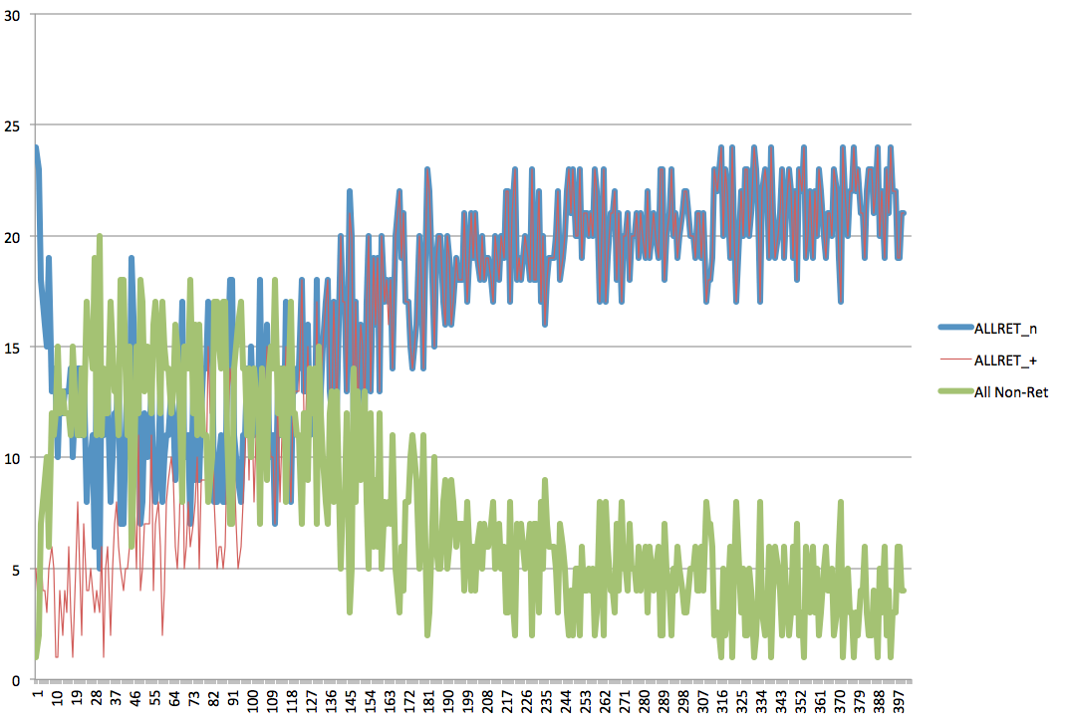
Outline
Change in proportion of strategy use and the accuracy using retrieval

Slide 44
Results
The interaction between pretraining and diffused input representation
Burner: 0 = no pretraining; or 1000
Dist0 : 0 = adjacent input unit with 1
The diffused inputs made the learning much slower
The effect of pretraining is most evident when input patterns were diffused.

Slide 45
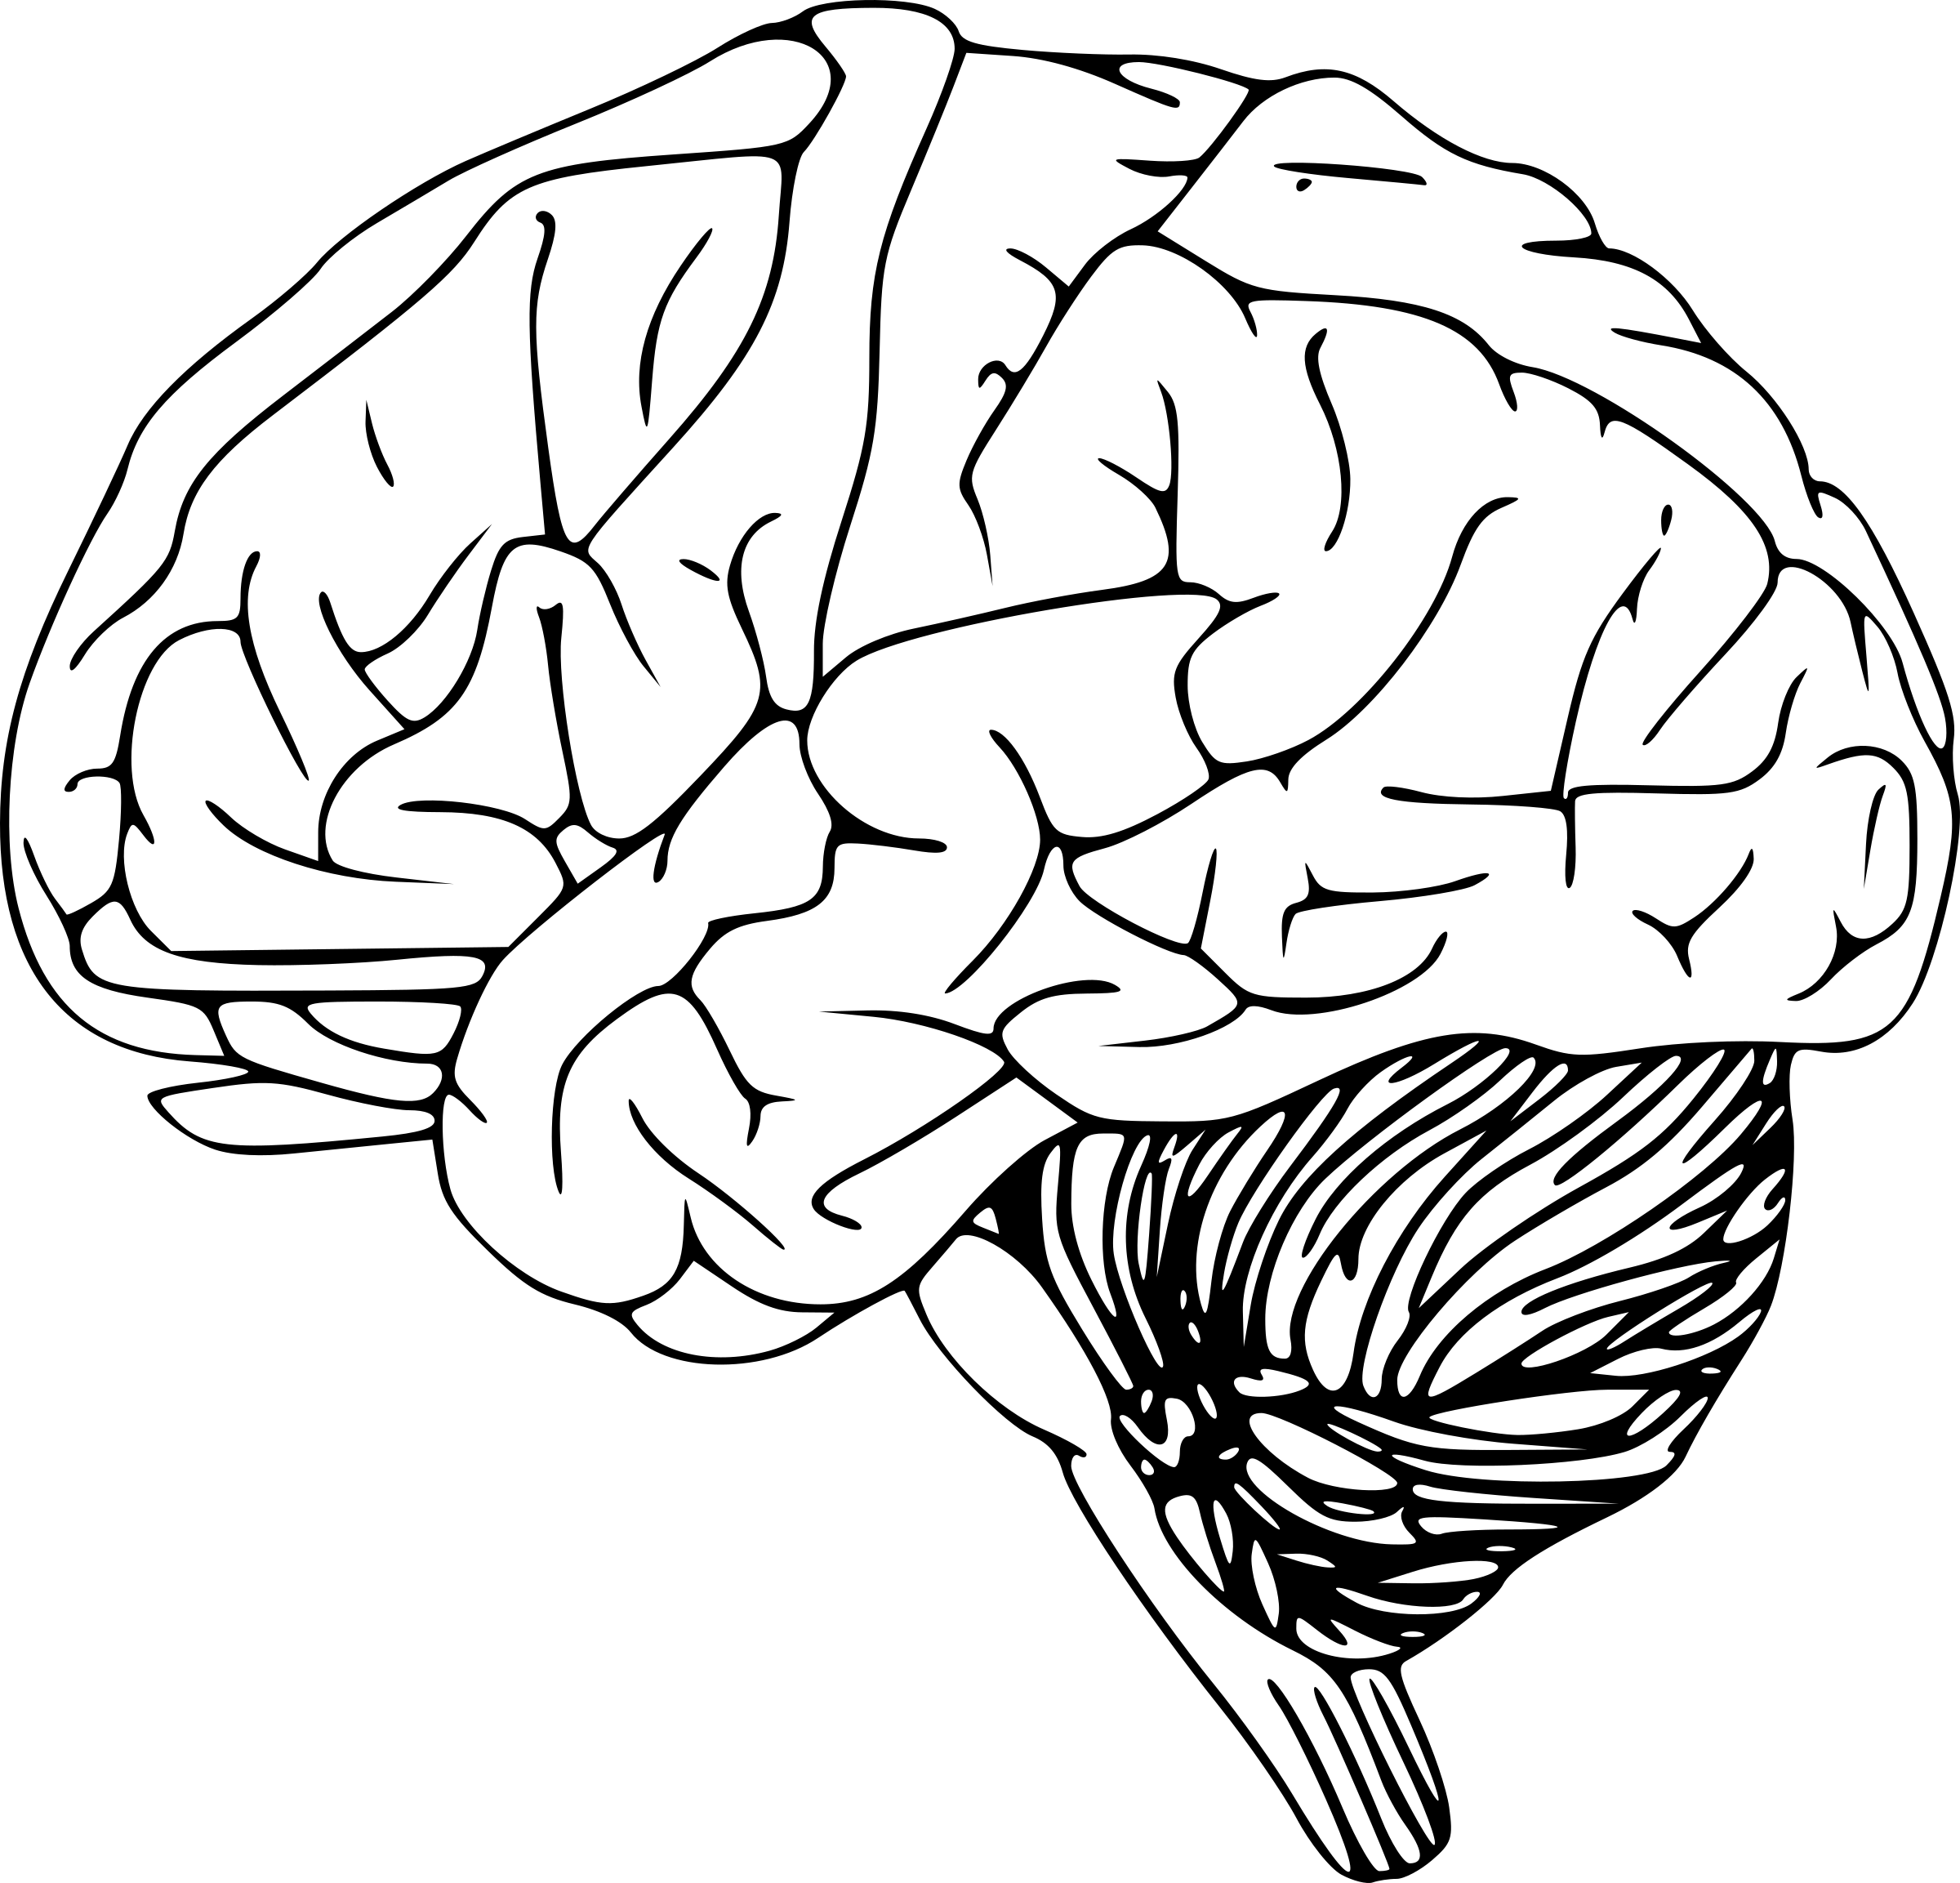



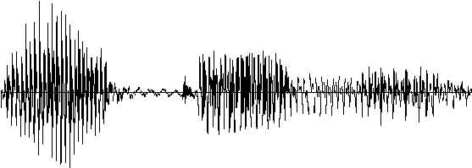
Future Directions
General motor: Finger activity and skill sequencing
General Frontal: activity initiation and in-task control
Motor output (fingers)
Interaction with language system
- Phonological awareness → fuzzy representations
- Verbal working memory → rehearsal in learning and online processing
2. Interaction with control system
Numerical knowledge
(PPC)
Pulling out fingers (overt strategies)
Prefrontal control
Auditory input
(problems)
Oral output (answer)
Visual input (fingers)
Assoc. memory
(MTL)
“Seven!”
MTL-mediated retrieval: associative/episodic encoding and decoding
“3 plus 4 ?”
Produce
answers
Hear problems

Slide 46
Thank you!

